Slide 1
ClubUML-Service Pack 2
Tom Cashavelly
The MITRE Corporation
Senior Software Systems Engineer
tcashavelly@mitre.org

Slide 2
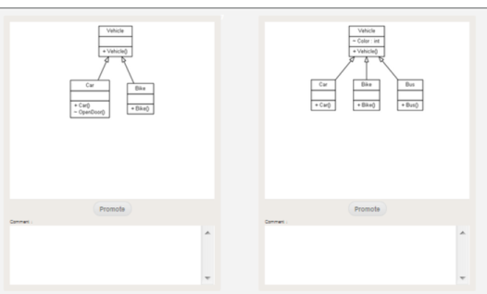




Overview
Features
UML Comparison Management Tool
Support Software Development Projects
Web-based (Thin Client)
UML Comparison
UML Merge
Roles/Permissions
Technical
Processes
Deployment Environment: Browser
IDE: Eclipse
Servers: Tomcat
UI: JavaScript/CSS
Database: mySQL
Agile Development
SCRUM

Slide 3
ClubUML Analysis
Spring 2013 Team
Sustainment (Maintenance)
User Driven Capabilities/Requirements
Asked the Users for new features
Low Cost/Effort (Timing)
Problems
Bugs (i.e., hardcoded, page errors, 404 messages)
Only Web Client
Limited Testing
Stove-piped

Slide 4
ClubUML – SP2 Recommendation
High Priority Bug Fixes
Identify all existing Bugs in Legacy System
Prioritize with leadership of Bugs
Allocate resources to fix/test highest priority
User Driven Requirements: Java Code Export
Generation of Java Code from UML diagrams
Ability to Generate Code unmerged UML diagram
Ability to export code directly into Eclipse project

